Slide 1
CVX_class 2024

Slide 2
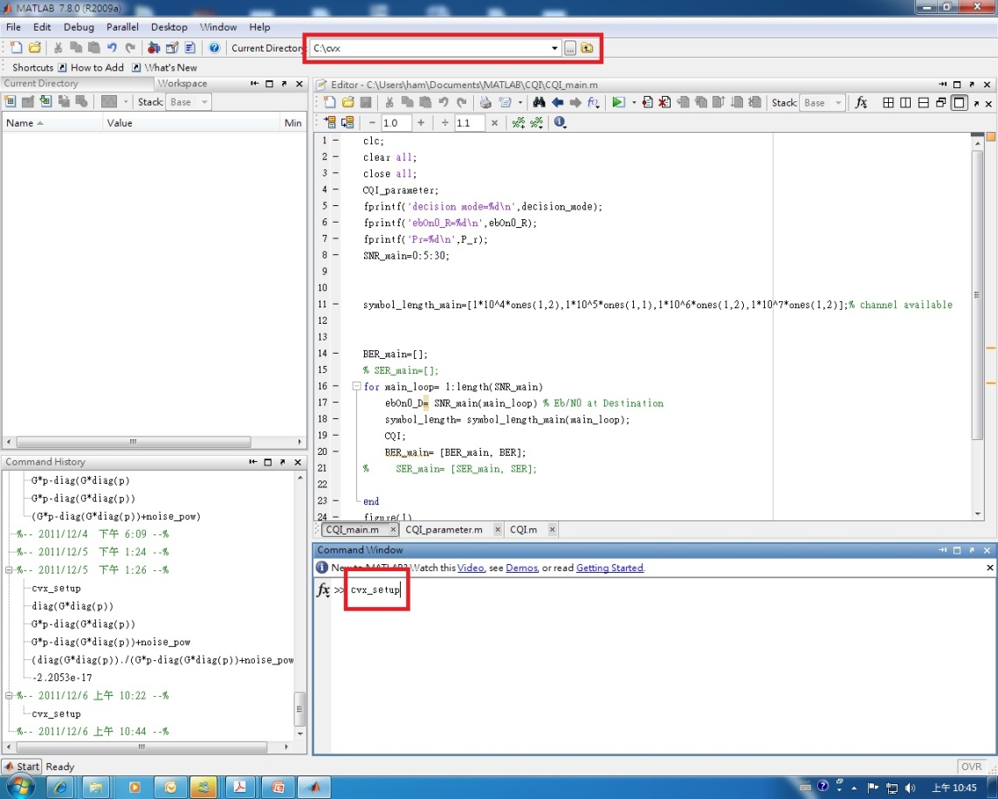
Cvx tool setup
Search for CVX tool ( http://cvxr.com/cvx/ )
Dezip to your assigned directory
Key cvx_setup in the matlab command window
No errors! cvx has been successfully installed.

Slide 3
Cvx programming
Between cvx_begin & cvx_end
cvx_begin
variables w(x,y) (complex, symmetric,…..)(refer 3.2)
minimize (convex function) or Maximize (concave function) (refer 3.3)
subject to
…… constraints(refer to 3.4)
cvx_end
Some special variables
  Cvx_optval
  Cvx_status
  Cvx_slvtol
  Cvx_slvitr

Slide 4
Some cvx functions
Quadprog
Linprog
Norm
  Norm(*,Inf)
  Norm(*,1)
Refer to 3.5 and appendix B

Slide 5

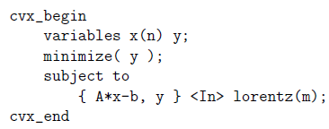
Others
Set (refer to 3.6 and appendix B.3)
➔
Dual variables (refer to 3.7)
Expression holders (refer to 3.8)
DCP ruleset (refer to 4)
Semidefinite programming using cvx (refer to 6)
Geometric programming using cvx(refer to 7)

Slide 6
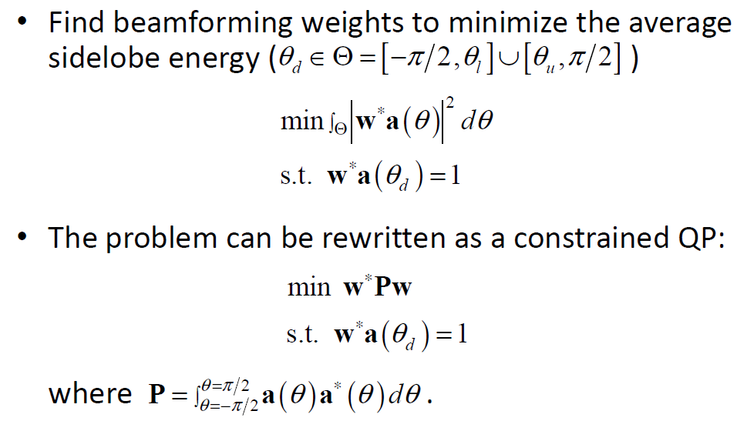
Q2: Beamforming Design (1/4)

Slide 7
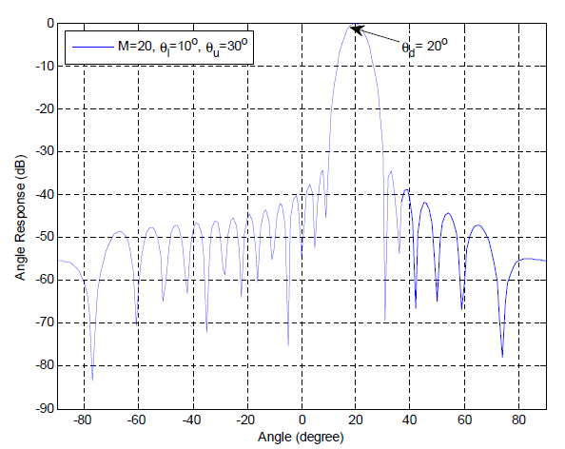
Q2: Beamforming Design (2/4)

Slide 8
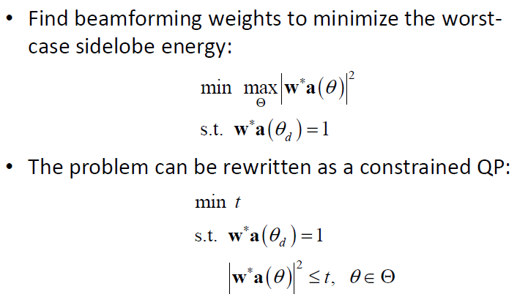
Q2: Beamforming Design (3/4)

Slide 9
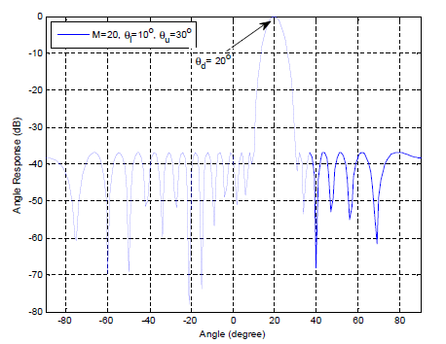
Q2: Beamforming Design (4/4)

Slide 10




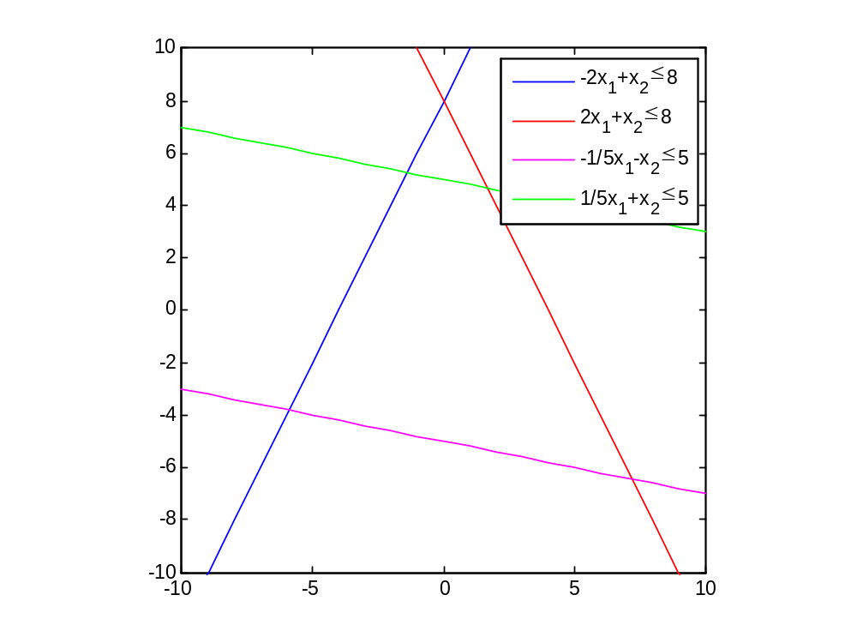
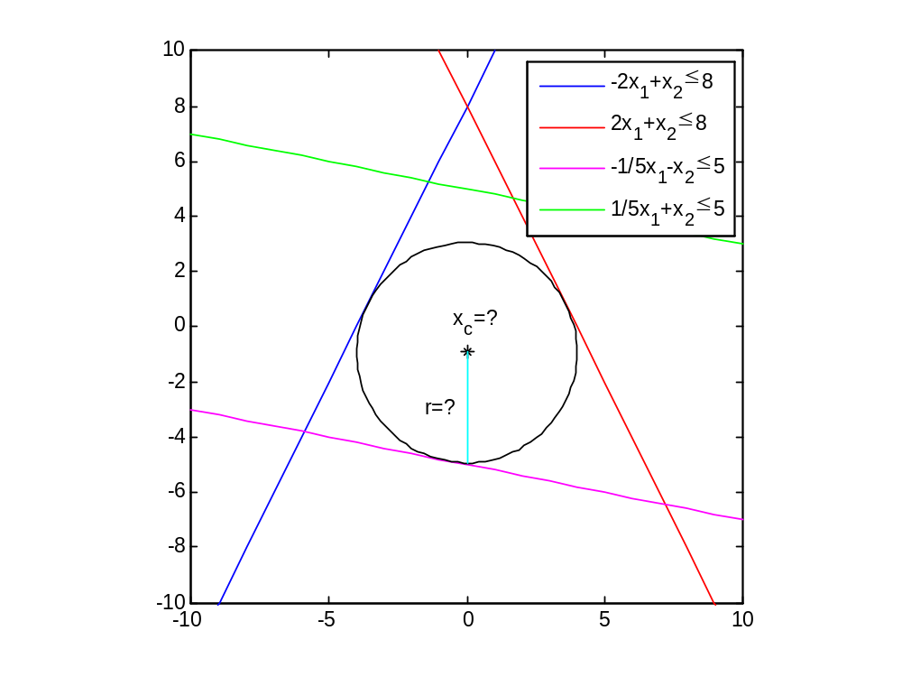
Q3: Chebyshev Center (1/2)
Consider a polyhedron composed of the halfspaces, , ,
, and , please plot the maximum norm ball inside the polyhedron and show the center and the radius of it

Slide 11
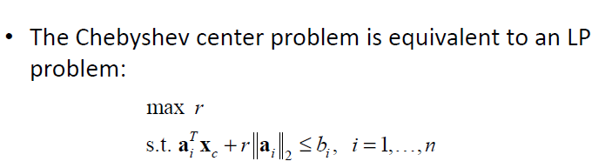
Q3: Chebyshev Center (2/2)

Slide 12
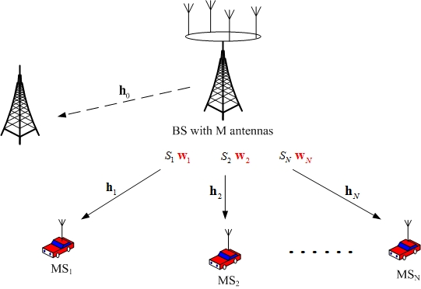
Q4: transmit beamforming (1/4)

Slide 13
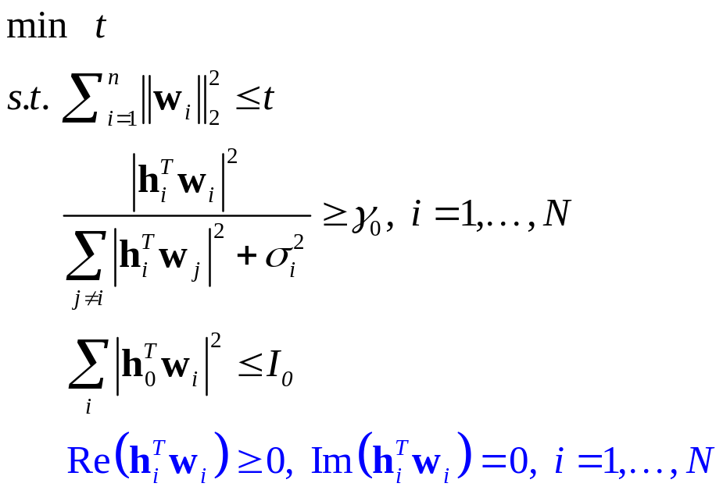
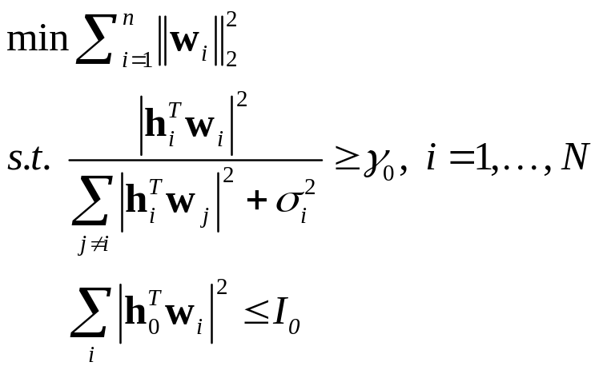
Q4: transmit beamforming (2/4)
min
Total power minimization
Epigraph method

Slide 14
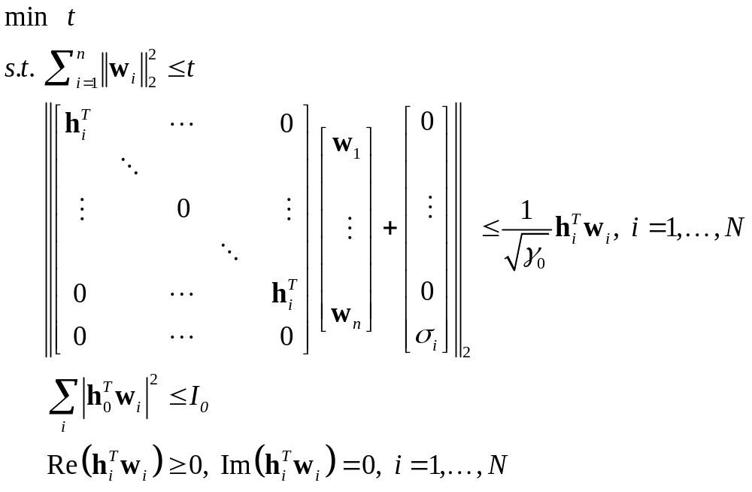


Q4: transmit beamforming (3/4)

Slide 15
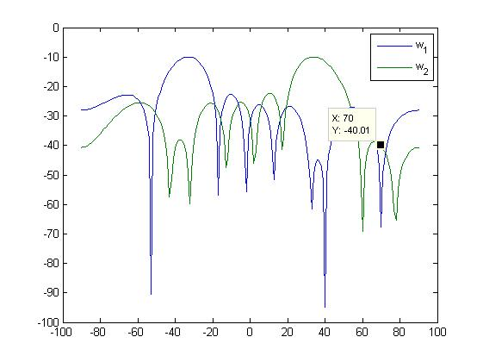
Q4: transmit beamforming (4/4)
Angle spectrum

Slide 16
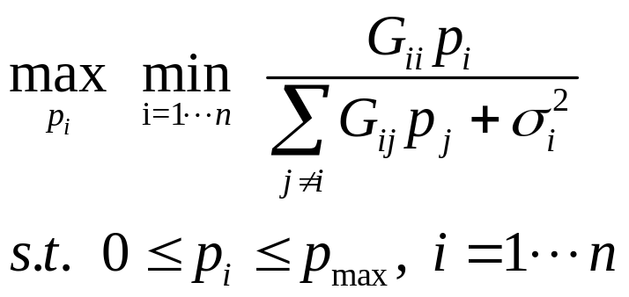
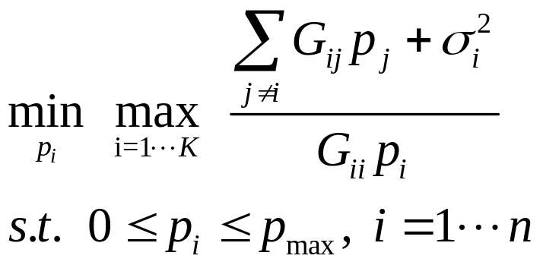
Q5: Power allocation (a) (1/3)
Worst case design

Slide 17
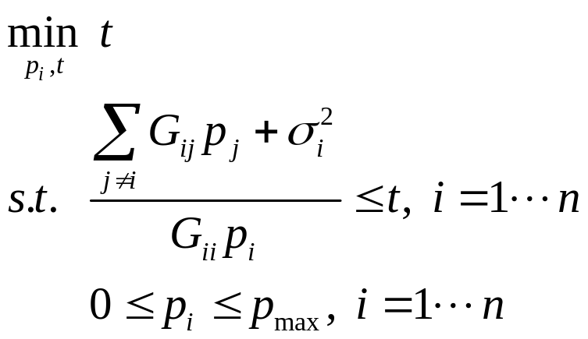
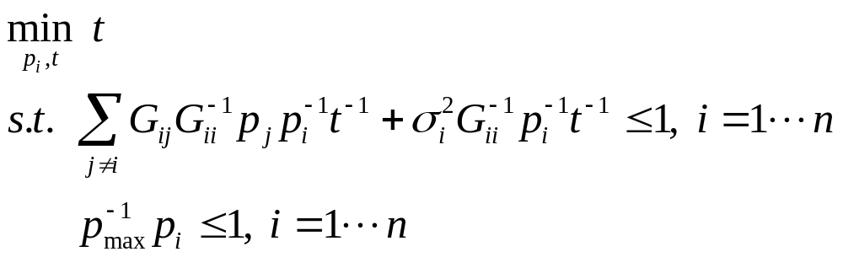
Q5: Power allocation (a) (2/3)
Epigraph form
Geometric Programming (GP) (refer to lecture 4, P4)

Slide 18
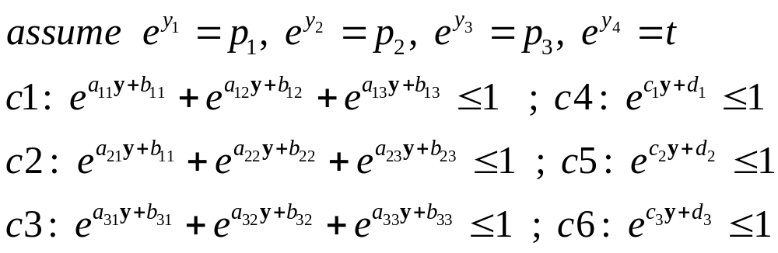
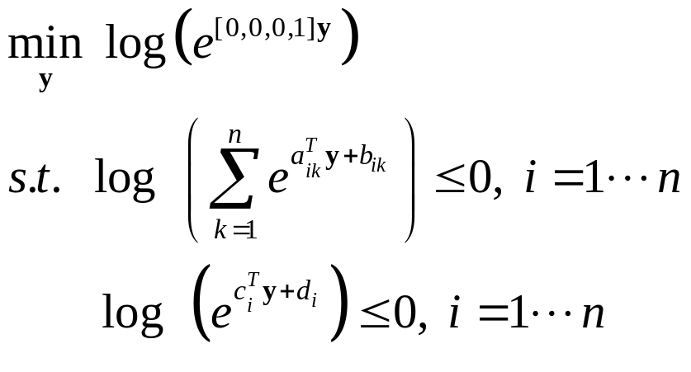
Q5: Power allocation (a) (3/3)
Variables of change
Convex problem

Slide 19

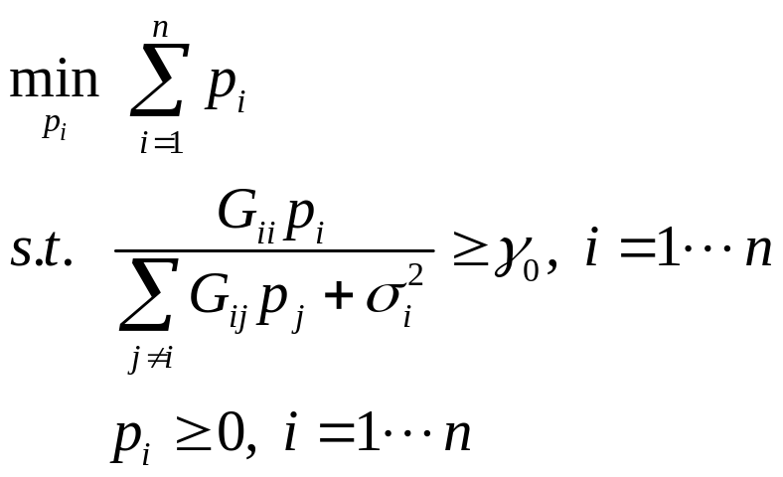
Q5: Power allocation (b)
Minimize the total power, subject to all the users’ SINRs are not less than
The problem can be represented as an Linear programming (LP) (refer to lecture 3, P22)

Slide 20
Q5: Power allocation (c)
Take the worst user’s SINR in (a) in place of
in (b), please re-design the transmit power , and compare with (a)

Slide 21
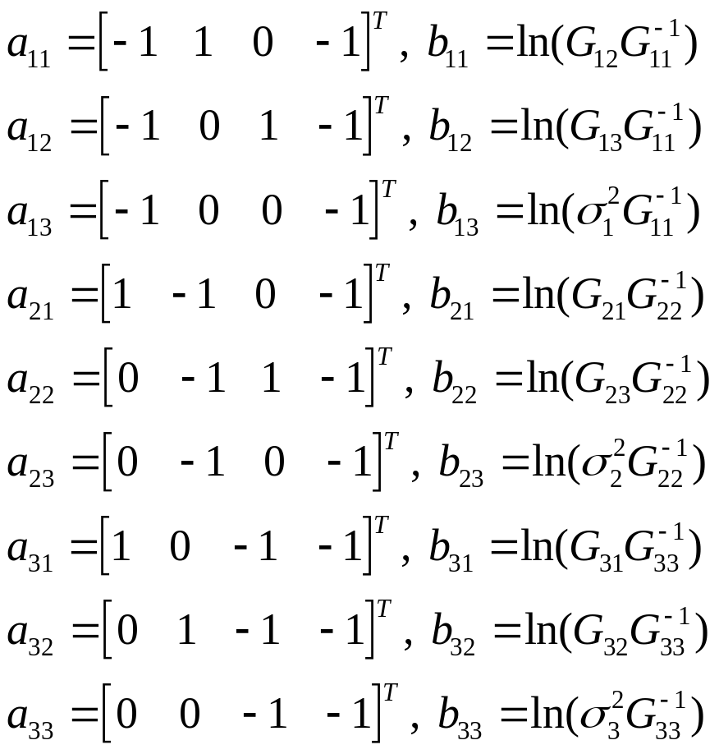
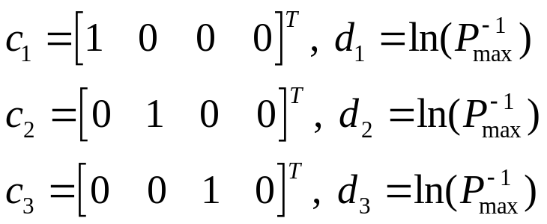
Appendix
Power allocation (worst case)

